Slide 1
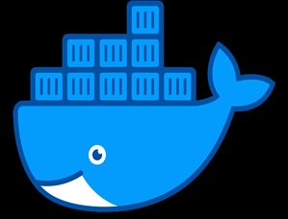
DOCKER – Deep Dive
- Sanskar Dwivedi Software Developer

Slide 2
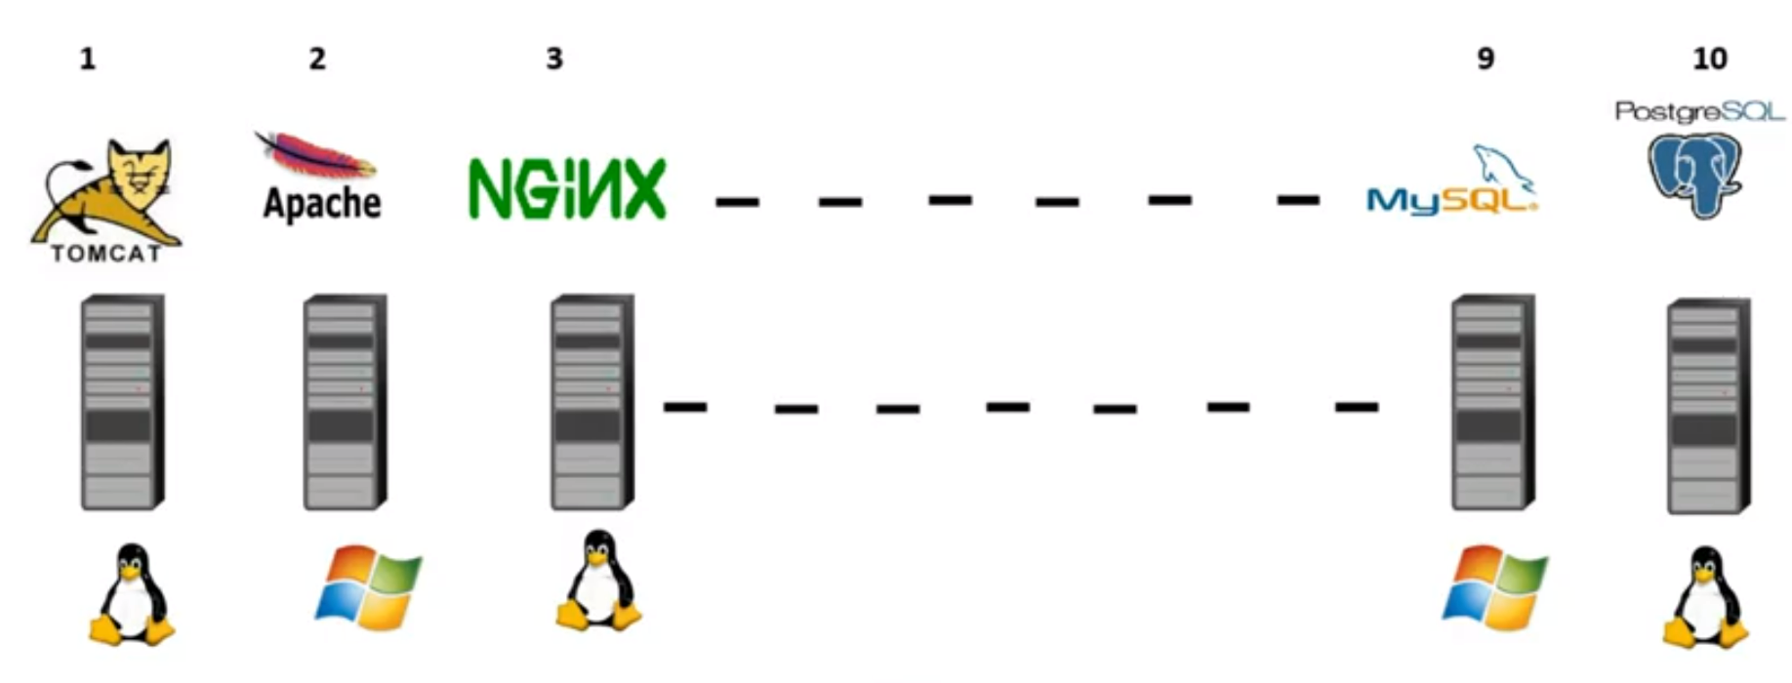
Physical Servers/On Premise/Bare Metal
Earlier, whenever a new application was built, at that point of time, a new physical server was purchased.
That specific server served only that application.
So, if there were 20 applications, we needed 20 Physical Servers. With 20 physical servers, we also needed 20 OS.
Each of these physical servers would consume power and produce heat, so we also need to take care of the power & cooling arrangements for each of the 20 servers.
Also, in some cases, we might also need 20 sets of storage and network infrastructure.

Slide 3
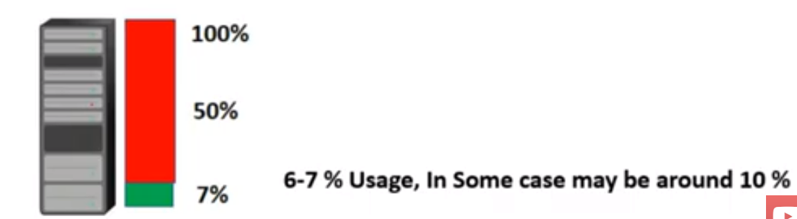
Physical Server: Problems
Each application deployment required a lot of infrastructure, which in turn also required a lot of money. Also delivering such infrastructure took a lot of time also (ranging from 6 months to 1.5 years in general)
Single point of failure – If a particular server crashes, there will be no instances of the application available.
The bigger problem was: “The application was not able to utilize all of the physical resources.” In 99% of the cases, the applications were able to utilize just 6-7% of the available resources.

Slide 4
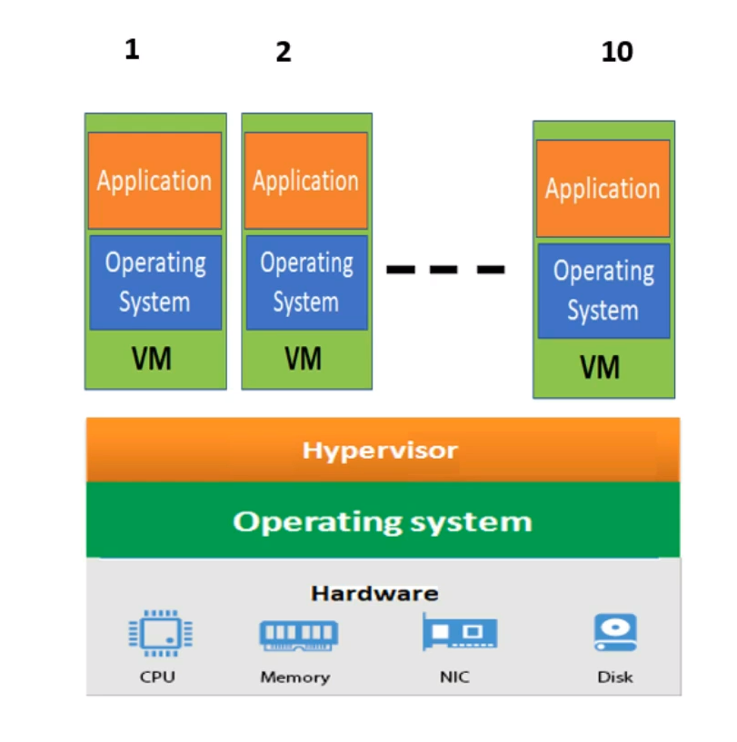
Virtualization
Virtualization is a technology that transforms your hardware components (such as CPU, RAM, Hard Disk) into software components.
In simple words, it gives us the power to divide the physical hardware into a set of virtual hardware.
Each set of these virtual hardware has a capability of getting an OS installed on them.
Basically, on one single machine, we can have N number of virtual machines with each machine having own virtual hardware and own OS.
Hypervisor, which is installed on top of OS, is a software that transforms the physical resources into virtual counterparts.
Note: We install hypervisor first, then we create a VM & then we install OS on each one of them.

Slide 5
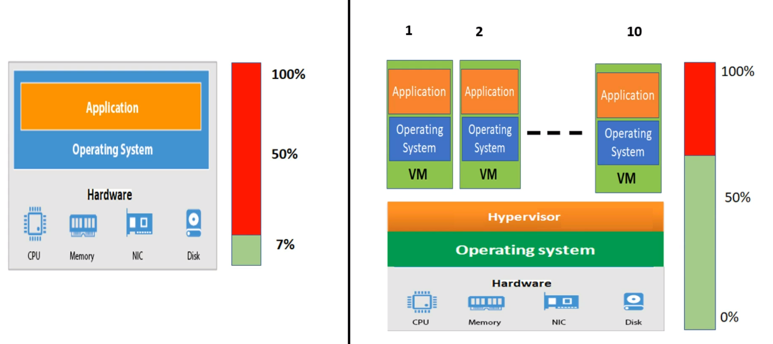
Virtualization: Benefits
- Utilization of resources increased.
Take previous example, for instance: We used 20 physical servers to deploy 20 applications on 20 physical machines. Now, we can deploy 10 applications on 1 physical machine and on 1 physical server. So, now we can deploy greater number of applications without any infrastructural overhead on one physical server.

Slide 6
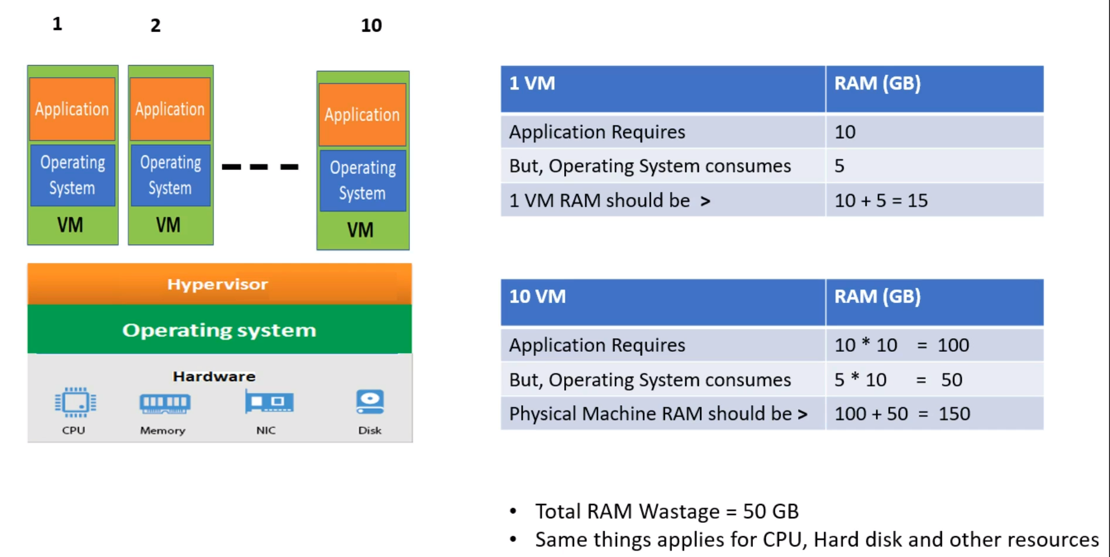
Virtualization: Problems
- Wastage of the physical resources. (Due to the presence of OS in every VM we create)

Slide 7
Virtualization: Problems
Memory Leak: In case of memory leak, a particular VM may try to consume more resources than they are allocated with. So, this may cause less availability of resources for other VM’s. In worst scenarios, they may even cause the OS to crash.
Single point of failure can still exist.
Hurts your application’s security – What you need to know about a virtual machine is that it is just a normal process running on a hypervisor. Every process has its own memory space, and you could treat it like the “virtual memory” in the virtual machine. Every memory page could be directly accessed by the hypervisor; therefore, it could be used to inspect all the confidential information stored in the virtual memory on your VM.

Slide 8
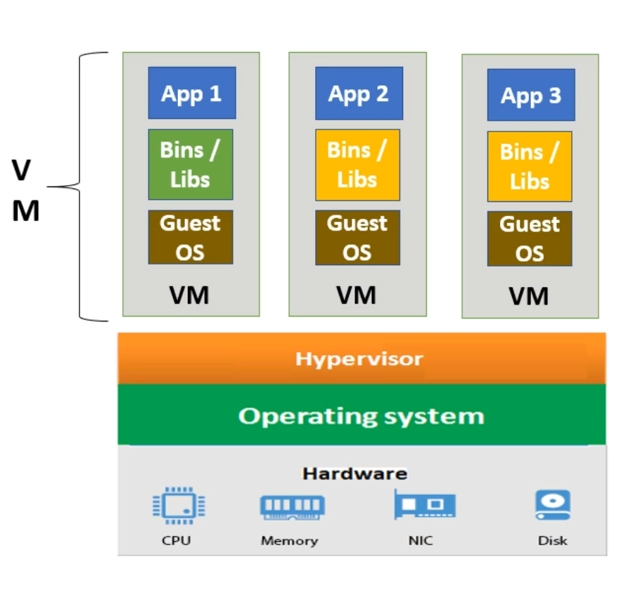
Terminologies
- Bins/Libs: If suppose you are running a java application, so we require 2 things – 1. Java Software => Bins(Binaries)
2. 3rd- Party Software on which the app depends => Libs (Libraries)
Guest OS vs Host OS: (as in virtualization) Both are OS. Guest is just an identifier given to the OS that is installed on the VMs. Host is the identifier given to the OS that is installed on the Physical Machines.
Virtualization

Slide 9
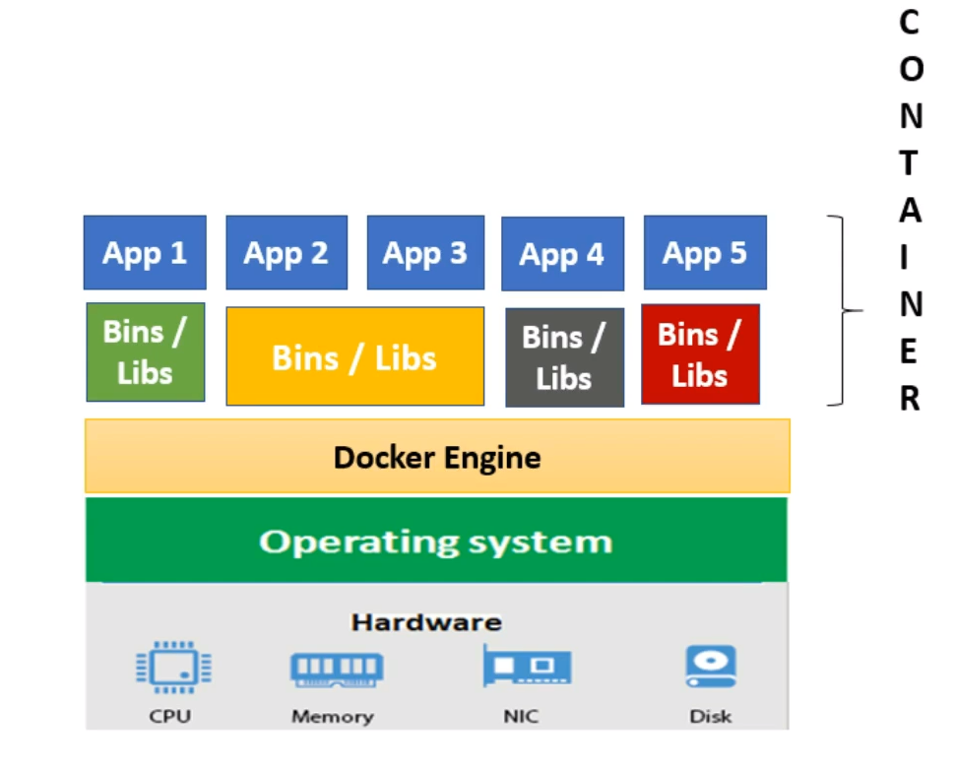
Containerization
There are 4 major differences between the Containers & Virtual Machines (as visible from picture):
Docker Engine in place of Hypervisor.
No OS in case of Containers.
Able to deploy a greater number of containers as compared to VMs.
Bins/Libs can be shared in case of containers but not in case of VMs. (e.g. App2 & App3 share same set of bins/libs) Note: Bins/Libs are something that are unique in each of the OS. Rest File Manager, Process Manager & Device Manager are shared as of the Host OS.

Slide 10
Containerization: Benefits
Provision of containers are very much faster than VMs.
Containers start & stop almost instantaneously (in fraction of seconds) as compared to minutes of time in VM’s.
The main reason why docker is so fast as compared to VM’s is – “Docker shares the kernel of the host OS and wherever necessary, it uses just the bins/libs of the required OS, saving a lot of resources that got wasted in OS”. This also gives one more added advantage: “No additional OS boot up time added when starting a container”.

Slide 11
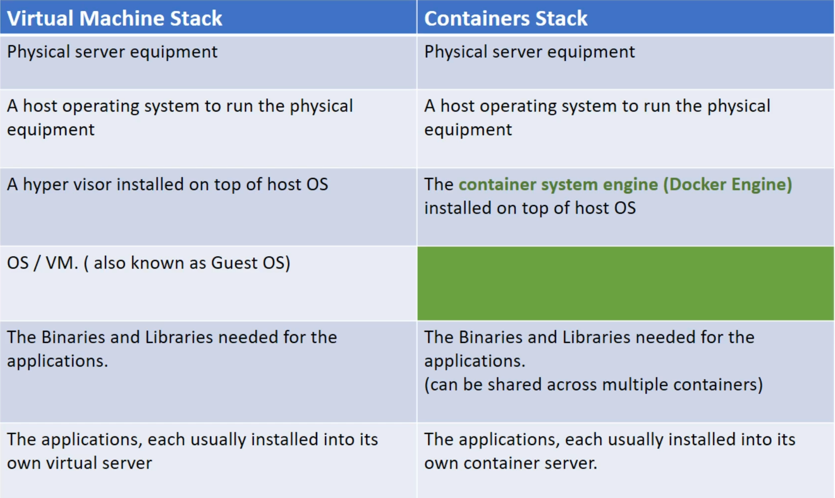
Components in Virtual Machine vs Components in Containers

Slide 12
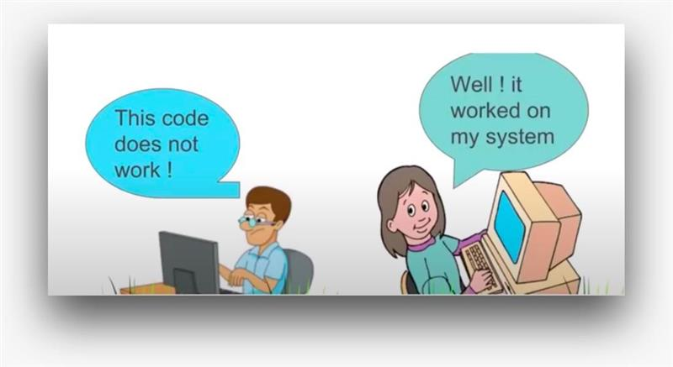
Why Docker?
As a developer, we would have noticed that sometimes our code works on Dev environment but when it comes to QA or Prod environment, it won’t work even though we had the same code running in all these environments.
WHAT COULD BE THE REASON?

Slide 13
Problems before Docker
1. Dependency version mismatch from one environment to another: Say, we are using Spring 4x version in Dev environment and the QA environment uses Spring 3x version, so the features that are available only in 4x version cannot be used in the QA environment, thus making the code not work. 2. Library/JAR Corrupted: Consider the Tomcat JAR, sometimes it is present in the Dev environment but not in the QA environment. In such cases also, the code won’t work. 3. Software Upgrade: Say, we are using Java8 in Dev (we might have used lambda, streams, etc.., specific to JDK8) but Java7 in QA environment, in such scenarios also the code won’t work.

Slide 14
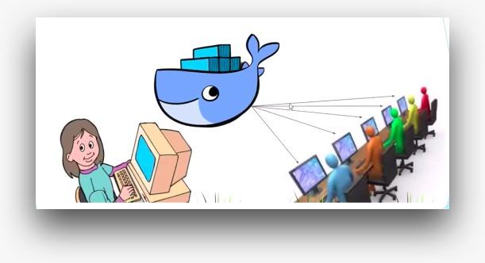
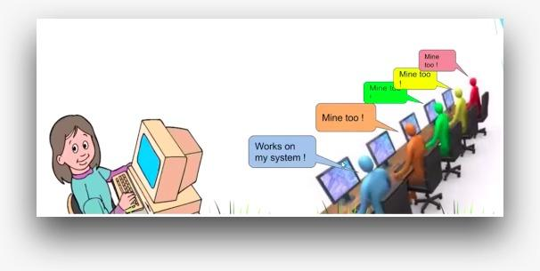
How Docker tackles all our issues?
- As a developer, I can keep all my dependencies, libraries & upgrade softwares in a container and can ship this container across all the environments. Hence, making all the dependencies, libraries & upgrade softwares accessible to all the environments for use, helping us to avoid any version mismatch issue. “Container allows a developer to package up all application with all of the parts it needs such as libraries and other dependencies and ship it all out as one package.” - Figure1: You can see that we are developing the code and we have added all our softwares, libraries and dependencies in the container. And then we have a docker engine where we have all the containers, and it is responsible for shipping to all the environments. - Figure2: All the environment points to the docker container and from docker container, we are getting the required dependencies and softwares, so now the code will work in each environment. All the developer can access the code and it will work for all of them.

Slide 15
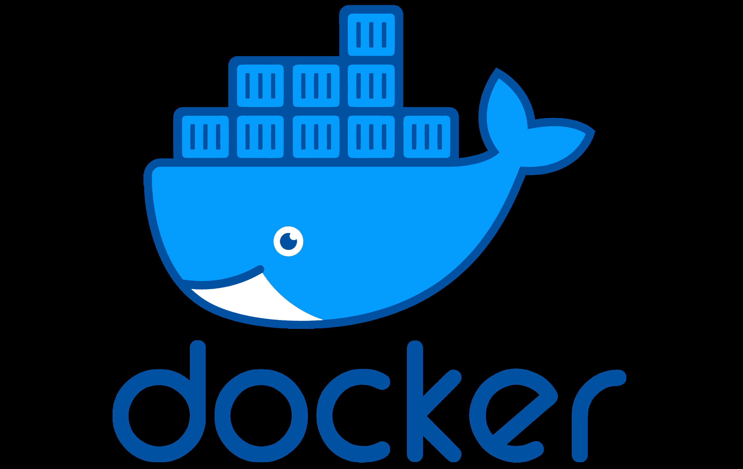
What is Docker?
Docker is a tool that simplifies building, shipping and running applications, where: Building: Creation of an application. Shipping: Movement of an application from one machine to other.
If I had to describe Docker in 3 words, I would say it is a: “ Software Containerization Platform”
Which means that:
You can build your application & once the application is built, you can package all its dependencies in a box called container.
And once that container is built, you can ship it to any other machine in the world and run it.
Your application should work perfectly fine without any external needs.

Slide 16
Docker (Contd…)
Opensource: If anyone has requirements that are not supported by Docker, then they are free to extend the docker functionalities as per their own needs. Hence, anyone is free to contribute to Docker.
Lightweight: Docker containers and applications running on those containers' startup very quickly. The reason being, docker shares the kernel of the host OS, hence no time needed for OS boot-up. And there are no overhead of CPU and resource utilization.
Secure: If there are 2 different containers running on the same OS, the process running on either of containers are isolated from. No docker container can look on the process’s data running on other container. Since each container gets their own CPU and network stack, it helps them to run independently and securely.
Docker runs natively on Linux & Windows Server (2016 or higher).
Docker runs on MAC & Windows machines with the help of VM’s. Which means that: To use docker on windows and mac machines, we have to install the VM first & the docker is installed on the VM.

Slide 17
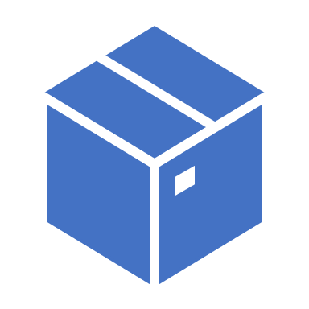
Containerization & Containers
Containerization: Way to package a software in a format that it can run isolated on a shared operating system.
Containers: Packages which contains applications with all its needs such as libraries and dependencies. Containers are like regular machines only, the difference being: Containers share the kernel of the host OS. They contain a very small fraction/part of OS, a part that allows them to run in isolation with any other process that runs on the same OS.

Slide 18
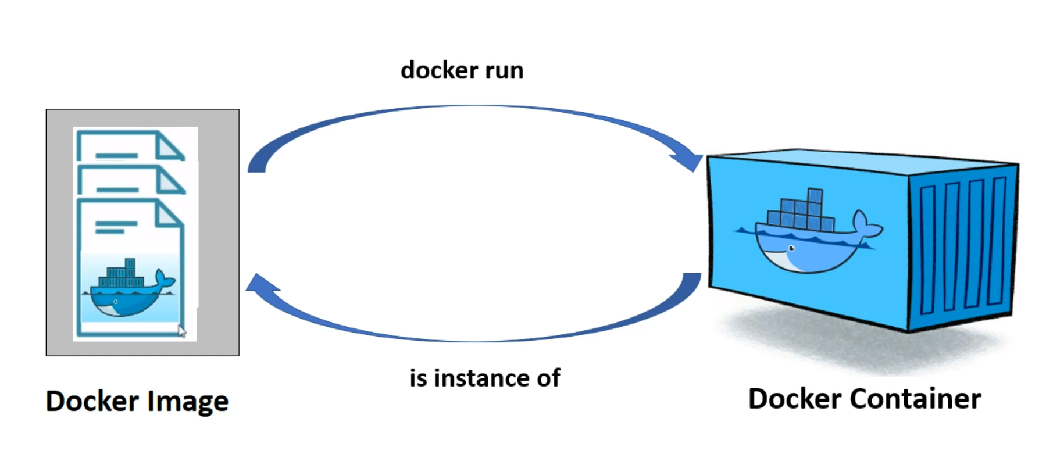
Docker Image & Docker Containers
Docker image is nothing but a set of read-only files, meaning, once the docker image is built, it can not be modified. But we can always create a new docker image from existing docker image by taking it as a base image.
Docker images are used to build the docker container.
When we run the docker image using ‘docker run’ command, it produces the output as a docker container.
We can also say- Docker containers are instance of docker images. Docker images are blueprint/definition of docker containers.
We can create any number of containers from the same docker image.
Docker Container is the actual place where the live application or the databases or any other software application runs.

Slide 19
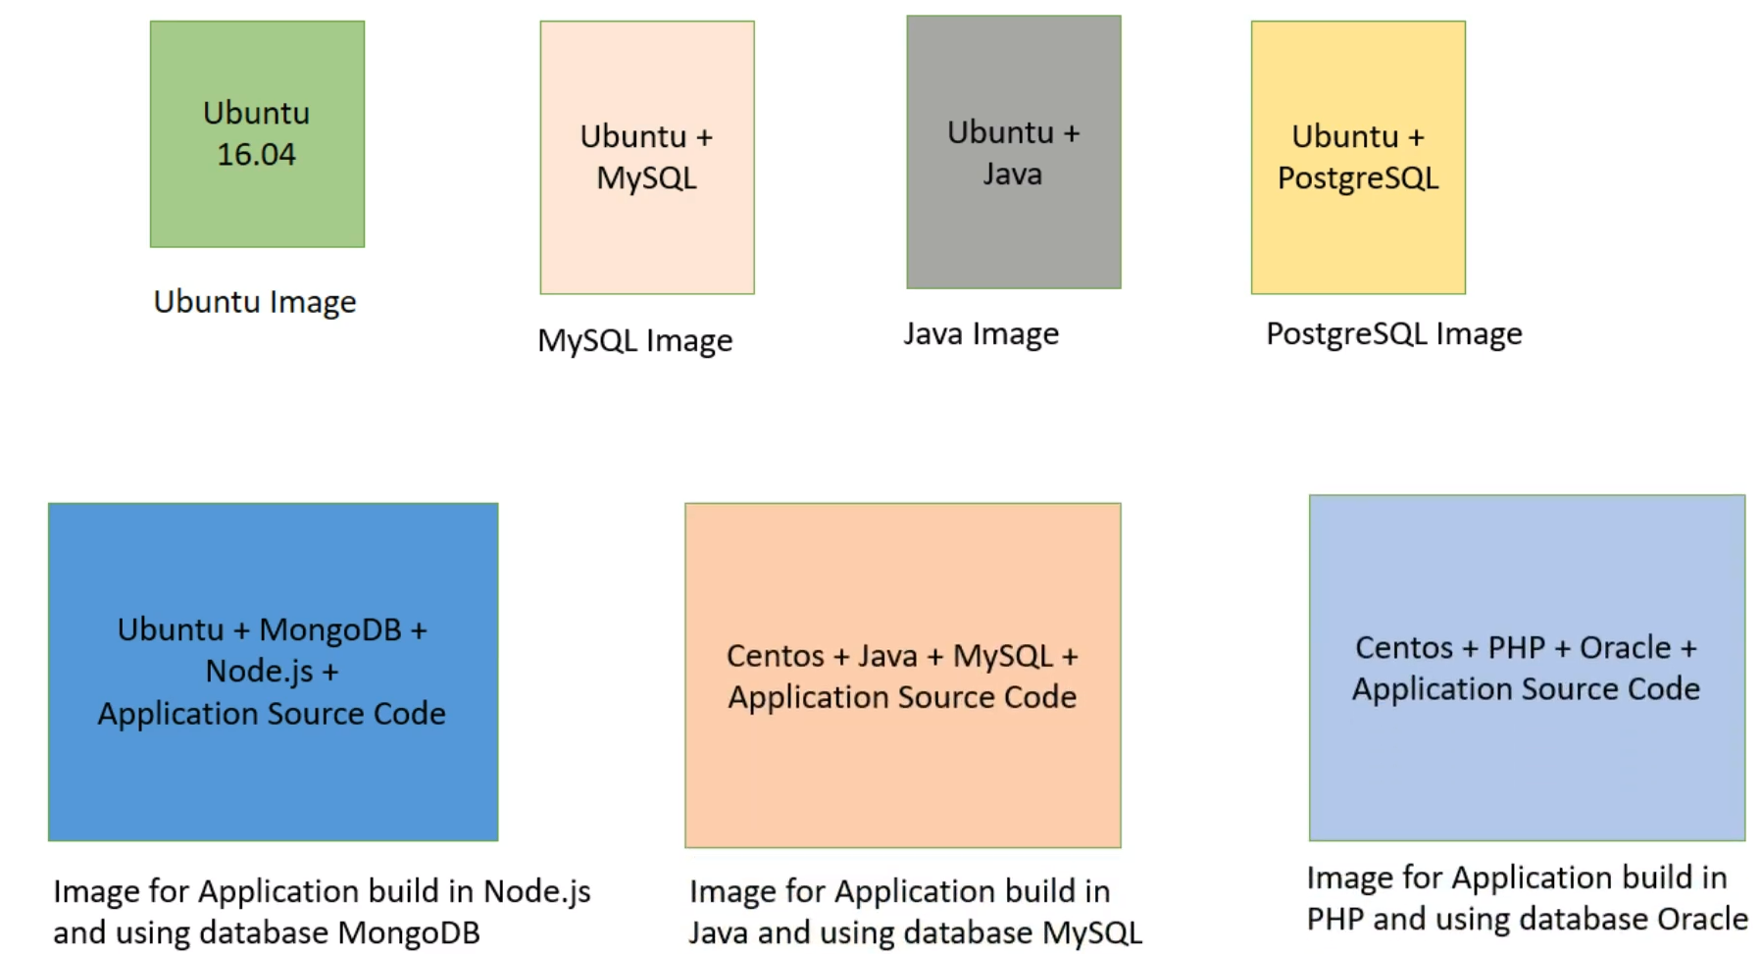
Docker Image & Docker Containers
What does Docker Image contain? => Every docker image at minimum contains some necessary set of files (these are nothing but small part of OS) which is required to run docker container as an isolated unit on any machine. This is the part which is in every docker image. Apart from this, it can contain any software that can be installed on any regular machine.
In terms of programming languages (OOPS Concept): Docker Image: Class Docker Container: Object of a class
Three ways through create a docker image: Through Jenkins build Through Dockerfile Docker Commit(not useful in prod)

Slide 20
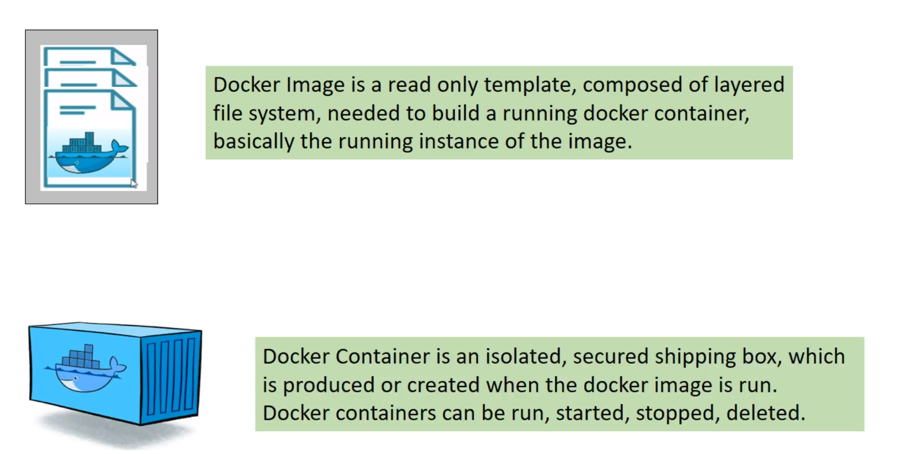
Docker Image & Docker Containers (To Sum Up…)

Slide 21
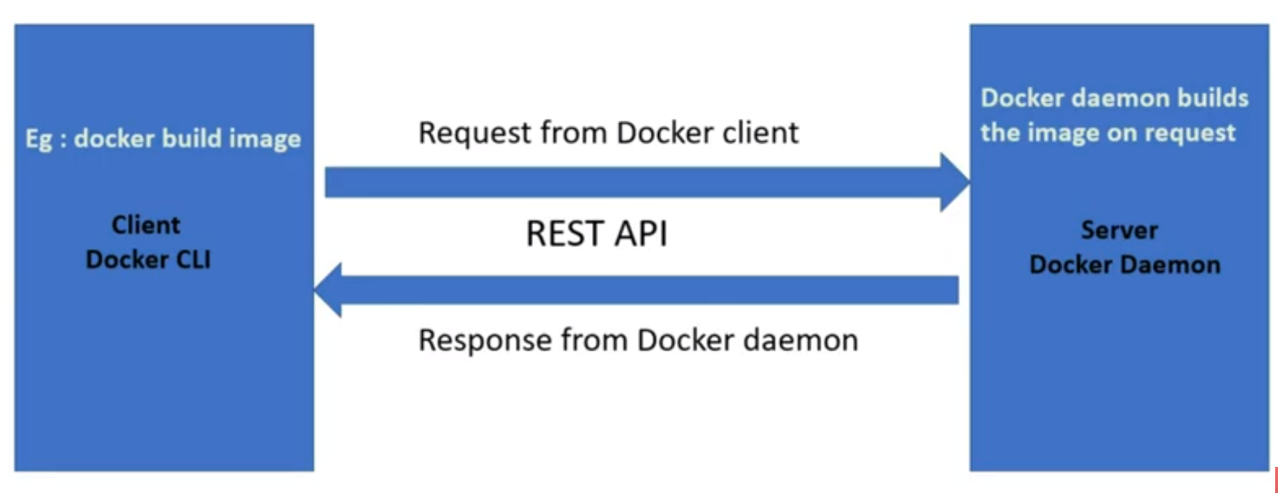
Docker Components
Docker is a Client-Server Application, so it follows all the conventions of a Client-Server application.
There are 3 major components of Docker: 1. Docker Daemon: This is nothing but a server & basically a long running program. This is the place where the actual work happens, whether it is building an image or creating a container or pushing of a docker image to docker repository. 2. REST API: An interface for the communication between docker daemon and docker client. 3. Docker Client: A command line interface to interact with docker daemon via docker commands. It is the only way to communicate with Docker Daemon.
Docker Daemon & Docker Client can both exist on the same host or can exist on different hosts also.

Slide 22
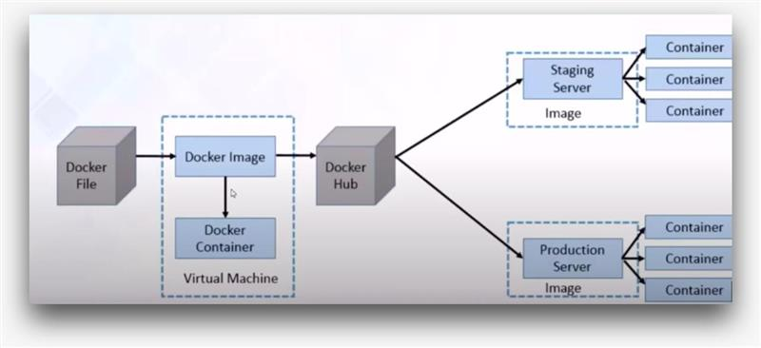
Docker Workflow
- As a developer, we write the Docker file and with the help of docker commands, we create a docker image (completely a skeleton of your application). Docker Container is a running instance of your docker image. - Once you have created the docker image, you need to keep it in Docker Hub. Docker Hub is analogous to repositories like Maven Central Repositories from where we get the required dependencies. Similarly, from Docker Hub, we can pull the required docker image. - As we see, the staging server or the production server can pull the images for their use from Docker Hub. And since docker image is completely a skeleton of our application with all the required dependencies, proper versions and upgraded softwares. We will never get version mismatch, JAR corruption and software upgrade issues like we used to get earlier.

Slide 23
Docker file
Set of instructions to create a docker image.

